Slide 1
Vending Machine
Team 7
Speaker：黄凌云

Slide 2
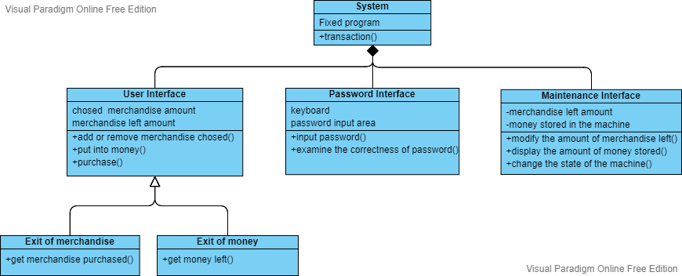
System Architecture

Slide 3
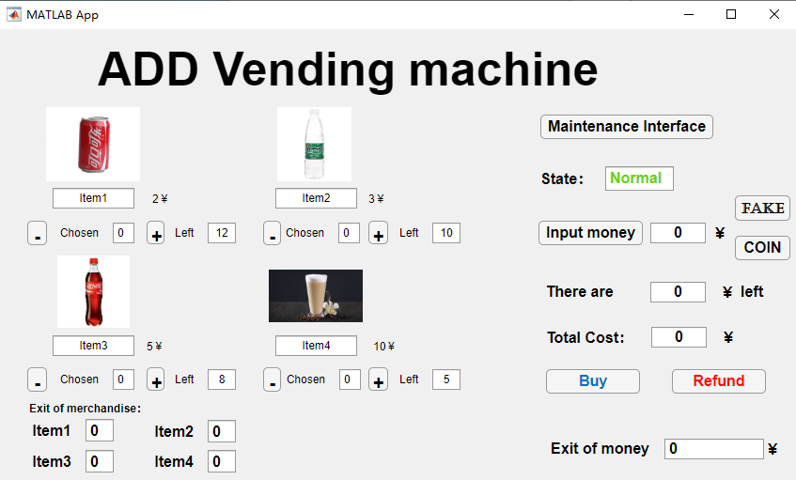
MAIN INTERFACE
Entrance to Maintenance Interface
Physical simulation of inputting fake money
Physical simulation of the withdraw port

Slide 4
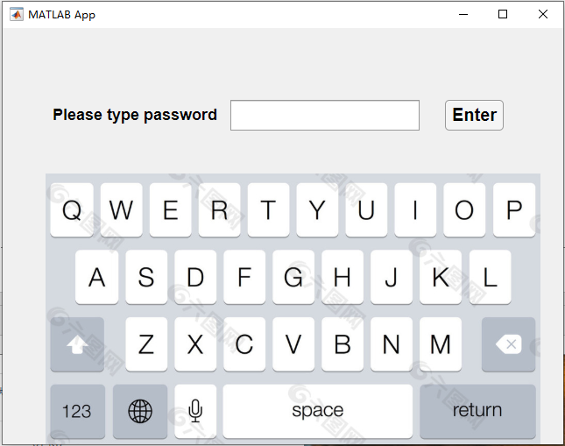
PASSWORD INTERFACE
Confirm password input
Physical simulation of keyboard

Slide 5
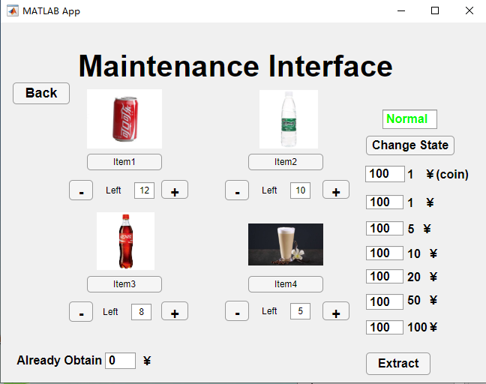
MAINTENANCE INTERFACE
Change the state of machine
Container of different money
Physical simulation of taking out money

Slide 6
DEMO PRESENTATION

